Slide 1


SMARTGRID PUZZLE SOLVER
DSCI-6612-01: Intro to Artificial Intelligence
SHAIK MURTHAZA
GANESH KAVALI
Submitted by:

Slide 2

OBJECTIVES
Create an AI algorithm that can generate unique and solvable Sudoku puzzles
Develop an AI algorithm capable of efficiently solving Sudoku puzzles of varying difficulty levels

Slide 3



Representing the Sudoku Board
Efficient Data Structure
Constraint Tracking
We use a NumPy array to represent the Sudoku board, allowing for fast and flexible manipulation of the grid.
By tracking the constraints for each cell, we can quickly identify valid options and prune the search space.
Visualizing the Board
Matplotlib helps us create clear visualizations of the Sudoku grid making it easier to understand the problem and track progress.

Slide 4

Exploring Possibilities
1
Candidate Generation
We systematically generate all possible candidates for each empty cell, considering the constraints of the grid.
2
Constraint Propagation
By updating the constraints after each candidate placement, we can quickly eliminate invalid options and streamline the search.
3
Backtracking Strategy
When a dead end is reached, our algorithm intelligently backtracks to explore alternative paths, ensuring a comprehensive search.

Slide 5
Generating Unique Puzzles
Randomized Initialization
Backtracking Validation
Controlled Difficulty
We start with a completely empty grid and randomly place numbers, ensuring each puzzle is unique.
After each number placement, we thoroughly validate the grid to confirm the solution is valid and unique.
By adjusting the number of clues provided, we can generate Sudoku puzzles of varying difficulty levels.

Slide 6
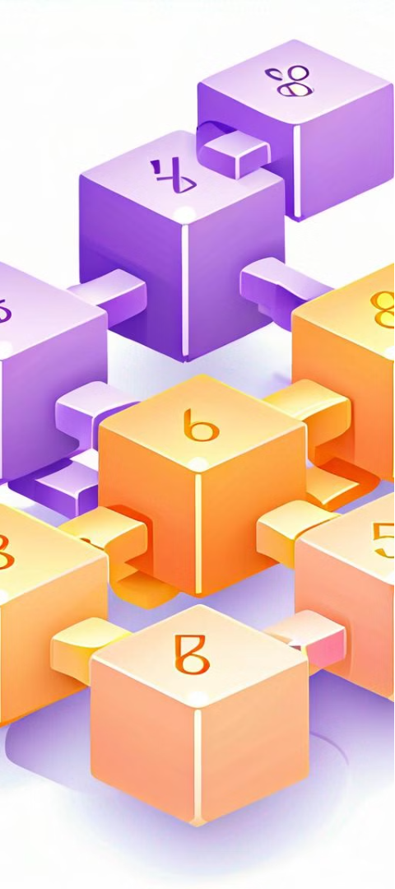
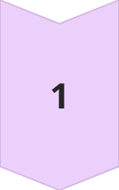
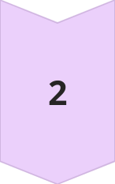
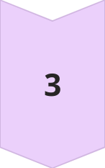
Optimized Solving Algorithms
Backtracking Optimization
Our advanced backtracking algorithm leverages heuristics and constraint propagation to significantly reduce the search space and improve solving times.
Concurrent Solving
By employing parallel processing, we can solve multiple puzzles simultaneously, further enhancing the efficiency of our solution.
Adaptive Difficulty
Our solver dynamically adjusts its strategies based on the puzzle's difficulty, ensuring optimal performance across a wide range of challenges.

Slide 7
Evaluating Algorithm Performance
1
Time Complexity Analysis
2
Uniqueness Verification
We measure the time taken to solve puzzles, comparing our optimized algorithm against standard backtracking approaches.
Our solution ensures that each generated puzzle has a single valid solution, meeting the Sudoku rules.
3
Scalability Testing
We test the robustness of our algorithms by solving puzzles of increasing complexity, ensuring consistent performance.

Slide 8




Enhancing the User Experience
Interactive Puzzle
Performance Tracking
Puzzle Variety
Social Features
Our app offers an engaging puzzle-solving experience, with interactive grids and intuitive controls.
Our app provides a diverse set of Sudoku puzzles, catering to players of all skill levels.
Users can share their achievements, compete against friends, and connect with the broader Sudoku community.
Users can track their solving times and progress, helping them improve their skills over time.

Slide 9
Evaluation Methodologies
Generate a Result to check the efficiency of algorithms.
Verify if Solutions adhere to Sudoku rules. Measure the time taken taken to solve puzzles.
Ensure each generated puzzle is unique and has a single solution.

Slide 10
Deployment and Accessibility
Platform
Cloud-based Architecture
Scalable and Reliable
Accessibility
Web Application
Mobile-friendly Design
Deployment
Containerization and CI/CD
Seamless Updates

Slide 11
Project Roadmap and Future Enhancements
Initial Release
1
Launch the core Sudoku puzzle generation and solving capabilities as a Python module.
2
Web Application
Develop a user-friendly web-based application that leverages the underlying algorithms.
Mobile Integration
3
Extend the platform to mobile devices, providing a seamless Sudoku experience on the go.
4
Advanced Features
Introduce new capabilities, such as collaborative puzzle-solving and personalized difficulty settings.

Slide 12

Conclusion
Our "SmartGrid Puzzle Solver" project combines the power of AI and optimization techniques to revolutionize the world of Sudoku. From generating unique puzzles to efficiently solving them, our comprehensive solution delivers a cutting-edge experience for Sudoku enthusiasts and algorithm aficionados alike.

Slide 13

THANK YOU

